Slide 1
Image Enhancement & Image Restorationn

Slide 2
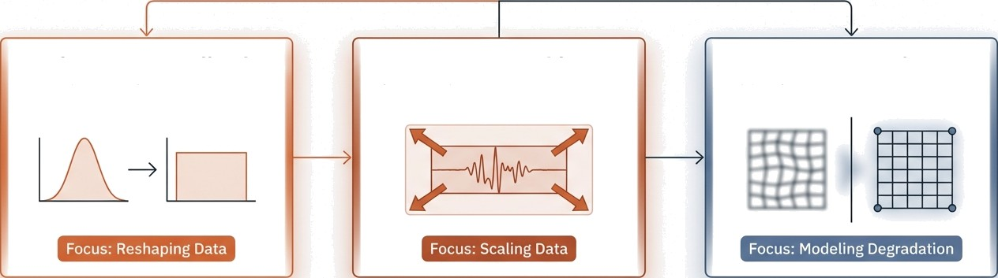

The Three Pillars of Image Processing
1. Histogram Equalization
Non-Linear Enhancement
2. Contrast Stretching
Linear Enhancement
3. Image Restoration
Objective Recovery
Subjective (Visual Appeal)
Objective (Mathematical Recovery)

Slide 3
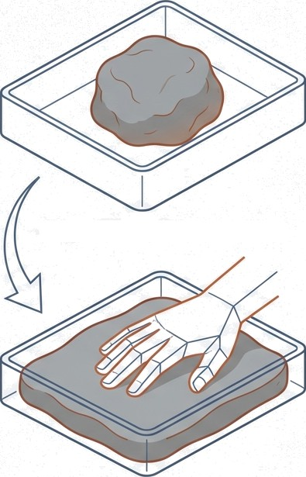
Pillar 1: Histogram Equalization
The Concept: Reshaping the Data
Definition: A contrast enhancement technique that redistributes gray levels to increase global contrast.
The Problem: When pixel intensities are clustered in a narrow range (e.g., all dark), details are mathematically hidden.
The Solution: The algorithm spreads these frequent values out, utilizing the full display range.
Key Use Cases: Medical X-Rays, Satellite Imagery, Low-light Photography.
Original Data (Low Contrast)
Equalized Data (High Contrast)

Slide 4
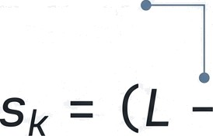









The Math of Equalization
Inside the Black Box: The Cumulative Distribution Function (CDF)
Scaling Factor (typically
255 for 8-bit images).
The normalized histogram
(probability of each gray level).
j —-0
The new mapped
pixel value.
The Cumulative Distribution Function (CDF). This step sums previous probabilities to create a ramping mapping function.
1. Compute Histogram
His ogi ain noleu ins an atilonate ano tomulnte in 8-oit images.
2. Calculate CDF
(Running Sum)
3. Map Input r to Output s
In # process ma Aping diagram. s, and
Output Of input r a OUtput s.

Slide 5
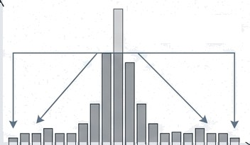
Methods & Limitations
Why Global Equalization isn't always enough.
Pro-Tip
CLAHE is the Gold Standard for medical imaging. It improves local contrast (seeing the bone fracture) without blowing out the noise in the soft tissue.
Clipped Peak
Redistributed
Pixel Intensity
The Limitation
Global equalization treats the entire image as one dataset. In smooth areas, this can aggressively amplify background noise, creating a grainy texture.
The Solution: CLAHE
Adaptive: Breaks image into small tiles.
Contrast Limited: Clips the histogram height
to prevent noise amplification.
Frequency

Slide 6

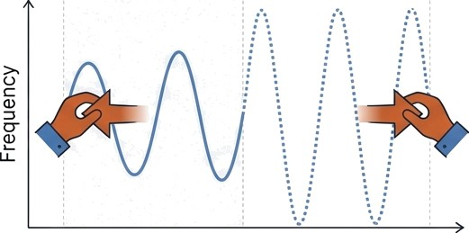
Pillar Contrast Stretching
The Linear Approach
Definition: A linear scaling method that forces pixel values to span the full available range (0—255).
Key Difference: Unlike Equalization, Stretching does NOT change the shape of the histogram. It only changes the scale.
The Elastic Band Analogy
The Math:
0 50% 255
Preserves shape, expands range.
₌ ₍ (r - r_nin) _{)*(L — 1)}
s
(r max - r min)

Slide 7

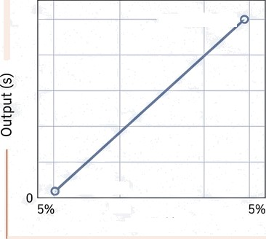


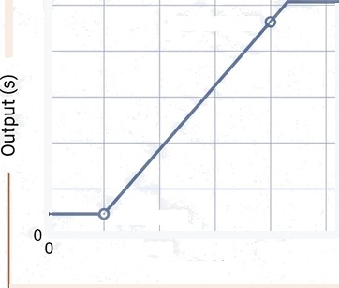

Variants of Linear Stretching
Understanding Transfer Functions in IBN Plex Sans
Min-Max Stretching Piecewise Linear
Percentile Stretching
255 r=20D.s=255
r=200, s=235
r=S0, s=20
255
r=r g %, s=255,
r=50, s=0 100
Input (r)
r=r ty, s=0
100
Input (r)
200
100 200
Input (r)
200
Standard Normalization. Darkest pixel becomes black; brightest becomes white.
Targeted Boosting. Increases contrast only in specific
mid-tone ranges.
Robust Stretching. Ignores outliers (e.g., dead pixels) to prevent skewed scaling.

Slide 8
The Showdown: Equatization vs. Stretching
Contrast Stretching Histogram Equalization
Mapping Logic | Linear (Simple Nath)
Histogram Shape | Preserved (3ust wider)
Control | Predictable & Safe
Noise Handling | Minimal Noise Amplification
Mapping Logic | Non-Linear (Statistical / CDF)
Histogram Shape | Flattened / Redistributed
Control | Aggressive & Automated
Noise Handling | High Risk of Noise Amplification

Slide 9
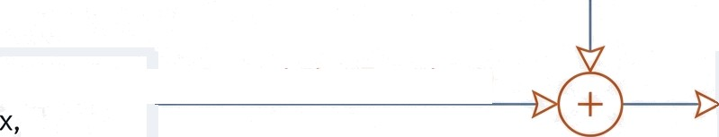

Pillar 3: The Science of Image Restoration
From Subjective Enhancement to Objective Recovery
Enhancement aims to “make it look good” to a human observer. Restoration
aims to mathematically recover the original data based on a degradation model.
The Degradation Model
Noise n(x,y)
Original Image f( y)
Degradation Function H
Observed Image
g(x,y)
Restoration

Slide 10






The Restoration Math Model
The Forensic Puzzle
a h(x, y) +
The Target
(Original Scene).
Convolution Operator.
The Blur/Degradation (e.g., tens defocus).
The Noise
(The disruptive factor that makes simple division impossible).
The Evidence (What we captured).
If Noise n(x,y) was zero, we could simply divide by H. Because Noise exists, direct inverse filtering fails.

Slide 11
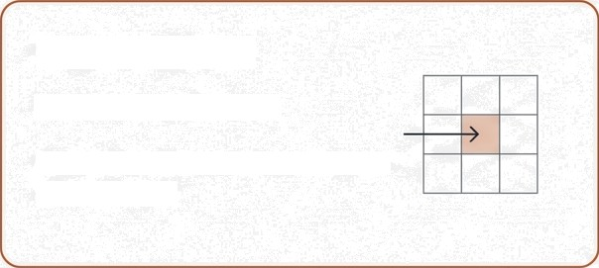

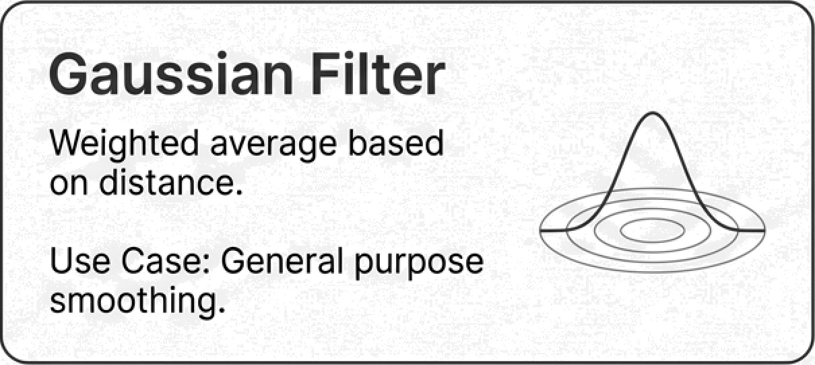
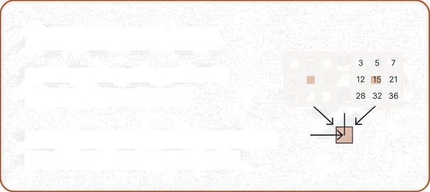
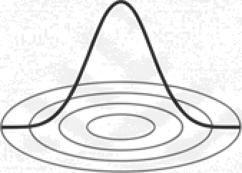
Restoration Method
: Noise Removal Filters
Mean Filter
Averaging neighbors.
Pros/Cons: Smooths noise but
blurs edges.
Median Filter
Replaces pixel with median
neighbor.
 | 5 | 7
12 |  | 21
28 | 32 | *6
—I
Use Case: Perfect for "Salt & Pepper" (impulsive) noise.
Bilateral Filter
Considers distance AND
intensity difference.
Superpower: Preserves Edges while smoothing textures.
Gaussian Filter
Weighted average based on distance.
Use Case: General purpose smoothing.

Slide 12





Restoration Method
Hierarchy of Techniques
Deblurring Techniques
Inverse Filtering
N a i ve approach
The Wiener
Filter
The Optimal Approach (MSE).
Constrained
Least Squares
The Regularized Approach.
Uses statistical properties of the noise and image to balance deblurring with noise suppression.
^{S}IJpp^{r£?SS}i^{O}’l•
Minimizes Nean
Square Error.
Imposes a “smoothness" constraint on the solution to prevent oscillating noise artifacts.
Verdict: Catastrophic failure in the presence of noise. It amplifies the noise term to infinity.

Slide 13
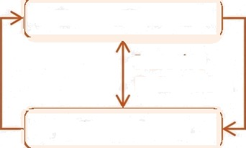
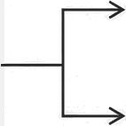

Restoration Metbo4 3: Blind Deconvolution
Solving for Two Unknowns
Black Box
Iterative
Refinement
Estimate Blur Kernel
Recovered Image I
Observed Blurry Image g(x,y)
Recovered Kernel h
Estimate Image
Scenario: We don't know the blur function (h). Common in handhetd photography (camera shake). The algorithm must guess the shake pattern and the image simultaneously.

Slide 14
Synthesis: Enhancement vs. Restoration
Image Enhancement
Subjective (Visual Appeal)
Heuristic I*Iethods
No physical model of de;¿radation
Example: Histogram Equalization
Image Restoration
Objective (Truth Recovery)
Mathematical I*1ethods
Relies on Degradation Model
(Blur + Noise)
Example: Wiener Filter

Slide 15






Executive Summary & Cheat Sheet
Key Definitions
CDF:
Cumulative Distribution Function, used for Equalization.
Histogram Equalization: Non-linear flattening of the histogram.
Contrast Stretching: Linear scaling (0-255).
Degradation Nodef: g = f* h + n.
The Toolkit
Salt & Pepper Noise Use Median Filter.
Exam Reminders
Equalization changes histogram shape; Stretching does not.
Inverse filtering fails because of Noise.
CLAHE limits contrast to prevent noise explosion.
Gaussian Noise
Use Gaussian/Mean
Filter.
Unknown Blur
Use Blind Deconvolution.
Known Blur + Noise
Use Wiener Filter.

